Slide 1

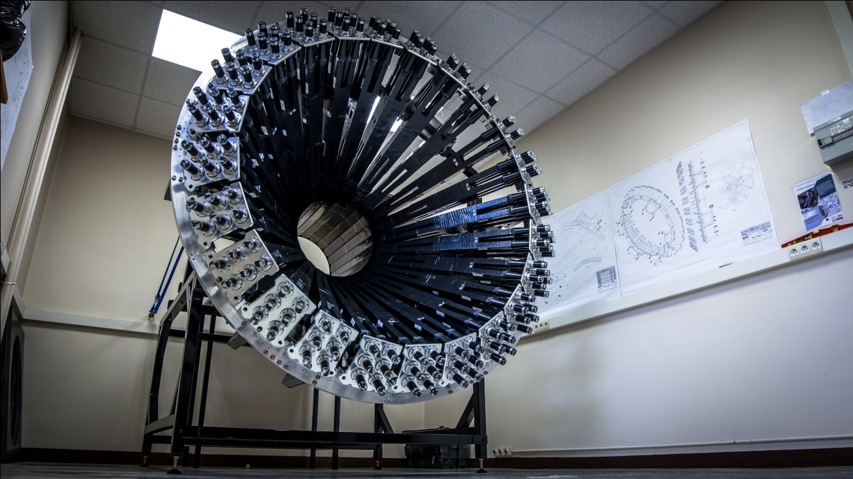
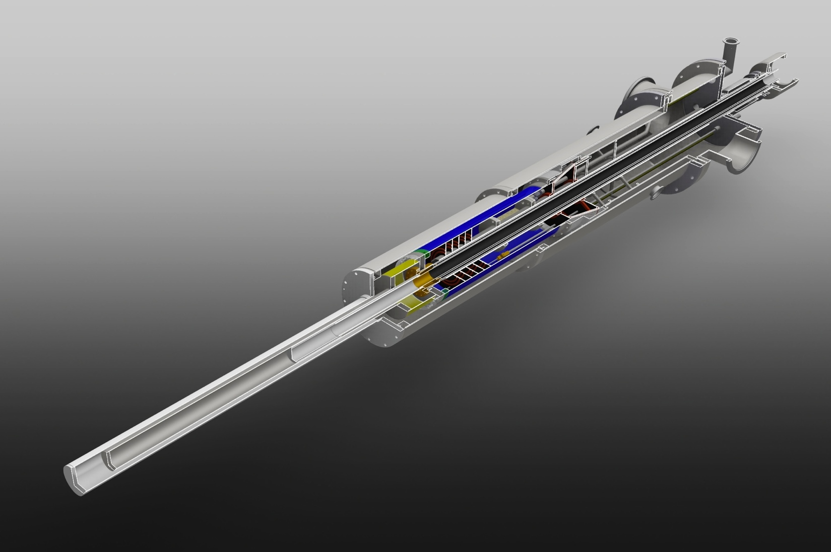
C12-15-004: DVCS, DIS, and SIDIS with a longitudinally polarized deuterium target
Silvia Niccolai
PAC44, JLab, 7/7/2015

Slide 2







C12-15-004: DVCS, DIS, and SIDIS with a longitudinally polarized deuterium target
Co-spokespersons:
Biselli (Fairfield U),
C. Keith (JLab),
S. Kuhn
S. Niccolai (IPN Orsay),
S. Pisano (INFN Frascati),
D. Sokhan (Glasgow U)
Silvia Niccolai
PAC44, JLab, 7/7/2015
Saclay
A CLAS collaboration proposal
Notes:
Point to the spokespersons, mention that there are institutions that signed, and say that the CLAS Collaboration endorsed the proposal after an internal review

Slide 3
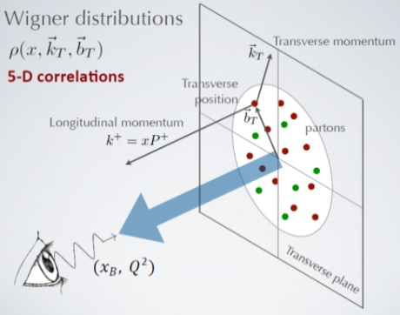
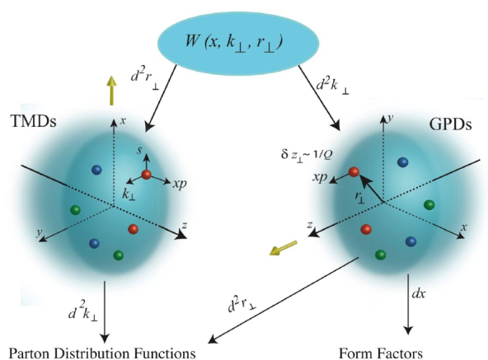
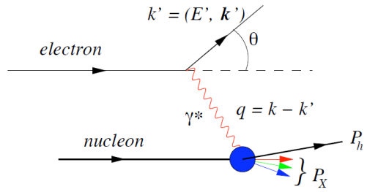
Multi-dimensional mapping of the nucleon
Wigner «Mother» functions are quantum-phase distributions of quarks
→ not directly accessible, we can only extract their 3D reductions
Picture by A. Bacchetta
e’
e
t
γ
γ*
(Q²)
x+ξ
x-ξ
N(p)
N(p’)
e
e’
e
e’
γ∗ (Q²)
γ∗ (t=Q²)
x
X
p
p’
p

Slide 4
Flavor dependence of parton distributions
Proton and neutron have different flavor composition → observables on these two target types are linked to different mixtures of u and d structure functions
Experiments with different targets must be performed to access the single flavor structure functions
No free neutron target exists, deuterium is used
Longitudinally polarized observables: nuclear targets, such as NH₃ and ND₃ are used
ND₃ typically has ½ the polarization of NH₃
CLAS12 program for longitudinally polarized observables:
E12-06-109: 30 days on NH₃, 50 days on ND3
More NH₃ approved later: E12-06-119b, E12-07-107, E12-09-007b, E12-09-009 → 120 days on NH₃
~2.5 more beam time for NH3 than ND₃
A combined analysis of CLAS12 data to extract flavor-dependent parton distributions will be dominated by the statistical error on the polarized-deuteron data

Slide 5
Deeply-virtual Compton scattering on the neutron with a longitudinally polarized deuteron target

Slide 6
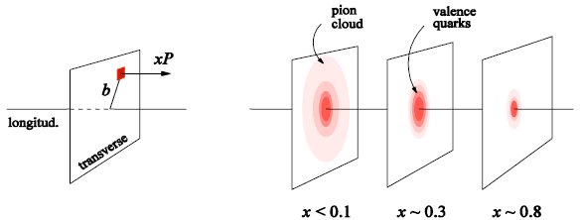
Deeply Virtual Compton Scattering and GPDs
e’
Q²= - (e-e’)²
x_{B} = Q²/2Mν ν=E_{e}-E_{e’}
x+ξ, x-ξ longitudinal momentum fractions
t = Δ² = (p-p’)²
x ≅ x_{B}/(2-x_{B})
e
t
γ
γ*
(Q²)
factorization
x+ξ
x-ξ
~
~
« Handbag » factorization valid
in the Bjorken regime:
high Q² , ν (fixed x_{B}), t<<Q²
H, H, E, E (x,ξ,t)
N(p)
N(p’)
At LO QCD, twist 2, chiral-even, quark sector → 4 GPDs for each quark flavor
~
conserve nucleon spin
Vector: H (x,ξ,t)
Tensor: E (x,ξ,t)
Axial-Vector: H (x,ξ,t)
Pseudoscalar: E (x,ξ,t)
~
flip nucleon spin
Nucleon tomography
M. Burkardt, PRD 62, 71503 (2000)
Notes:
The proposed experiment is part of the category 3D structure of the hadron, via the study of generalized parton distributions.
The channel more directly interpretable in the terms of GPDs is DVCS, which is the electroproduction of a real photon on a quark of the nucleon. You see it here represented by the « handbag » diagram, which shows the virtual photon that interacts with one of the quarks of the nucleon, which propagates and then radiates a real photon, before « going back » in the nucleon. The handbag implies the factorization of this reaction in two parts: the top one, describing the virtual-photon/quark interaction, which is calculable in perturbative QCD; and the bottom one, describing the partonic structure of the nucleon, which is encoded in the generalized parton distributions. The handbag factorization holds in the so-called Bjorken regime, which requires to be at high Q2 with respect to the momentum transfered to the proton (t).
At leading order and twist in QCD, considering only quark-helicity conserving quantities and the quark sector, there are 4 GPDs, H, Htidle, E, Etilde, and they depend on three variables: x, the momentum fraction carried by the struck quark, csi, the difference of the quark momentum between initial and final state (which is linked to the Bjorken variable xB) and t, the momentum transfered to the nucleon. There are 4 GPDs to describe different combinations of nucleon spin with respect to the quark’s helicity, for the initial and final states.
The GPDs can provide us a tomography of the nucleon, providing information about the transverse position of partons having a given longitudinal momentum.

Slide 7
Deeply Virtual Compton Scattering and GPDs
e’
Q²= - (e-e’)²
x_{B} = Q²/2Mν ν=E_{e}-E_{e’}
x+ξ, x-ξ longitudinal momentum fractions
t = Δ² = (p-p’)²
x ≅ x_{B}/(2-x_{B})
e
t
γ
γ*
(Q²)
factorization
x+ξ
x-ξ
~
~
« Handbag » factorization valid
in the Bjorken regime:
high Q² , ν (fixed x_{B}), t<<Q²
H, H, E, E (x,ξ,t)
N(p)
N(p’)
At LO QCD, twist 2, chiral-even, quark sector → 4 GPDs for each quark flavor
~
conserve nucleon spin
Vector: H (x,ξ,t)
Tensor: E (x,ξ,t)
Axial-Vector: H (x,ξ,t)
Pseudoscalar: E (x,ξ,t)
~
flip nucleon spin
Nucleon tomography
Quark angular momentum (Ji’s sum rule)
X. Ji, Phy.Rev.Lett.78,610(1997)
M. Burkardt, PRD 62, 71503 (2000)
Notes:
Among the information that GPDs can bring, a very important one is that they can allow us to compute the quark angular momentum, which is given by, according to Ji’s sum rule, the second moment in x of the sum of the GPDs H and E calculated at t=0.

Slide 8
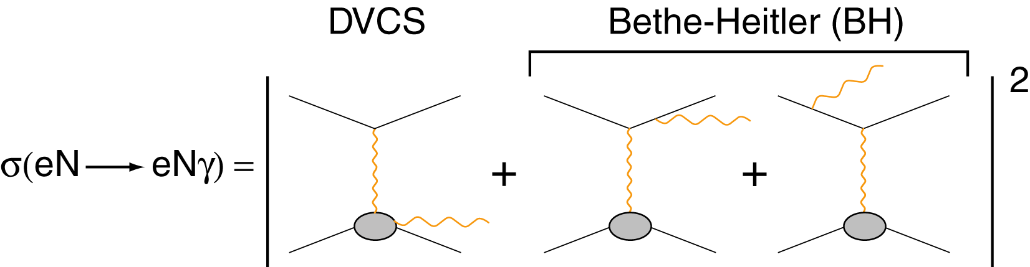
Accessing GPDs through DVCS
DVCS allows access to 4 complex GPDs-related quantities: Compton Form Factors (ξ,t)
Only ξ and t are accessible
experimentally
BH is calculable
(electromagnetic FFs)
γ
φ
e’
e
leptonic plane
N’
hadronic
plane
Notes:
The DVCS amplitude is proportional to a linear combination of 4 complex GPD-related quantities, which are called Compton Form Factors. The real part of the CFF is an integral over x of a GPD, while the imaginary one is the GPD computed at the x=+-csi points. So, measuring DVCS allow us to only obtain the csi and t dependence of GPDs, while x is integrated over.
The DVCS final state is the same as the BH one. BH is well known and calculable from the electromagnetic FF.
If we measure cross sections or DSA we are sensitive to the real part of the CFFs. If we measure single-spin asymmetries we are sensitive to the DVCS/BH interference, which is linked to the imaginary part of the CFFs.
By looking at the phi dependence of the epg observables, the various terms of the epg amplitude can be singled out.

Slide 9
Sensitivity to CFFs of DVCS spin observables
Twist 2
approximation
(-t<<Q²)
(ξ= x_{B}/(2-x_{B}) k=-t/4M²)
Proton Neutron
Polarized beam, unpolarized target:
~
Im{H_{p}, H_{p}, E_{p}}
~
s^{I}_{1,unp} ~ sinφ Im{F₁H + ξ(F₁+F₂)H -kF₂E}
~
Im{H_{n}, H_{n}, E_{n}}
Unpolarized beam, longitudinal target:
~
~
~
Im{H_{p}, H_{p}}
s^{I}_{1,UL} ~ sinφIm{F₁H+ξ(F₁+F₂)(H + x_{B}/2E) –ξkF₂ E+…}
Im{H_{n}, E_{n}}
~
Polarized beam, longitudinal target:
Re{H_{p}, H_{p}}
~
c^{I}₁,_{LP} ~ (A+Bcosφ)Re{F₁H+ξ(F₁+F₂)(H + x_{B}/2E)…}
Re{H_{n}, E_{n}}
Unpolarized beam, transverse target:
Im{H_{p}, E_{p}}
Δσ_{UT} ~ cosφsin(φ_{s}−φ)Im{k(F₂H – F₁E) +… }
Im{H_{n}}
Notes:
At leading twist, the sinfi term of the single-spin asymmetries and the cosphi/numerator term of the DSA are proportional to the interference of DVCS and BH, and are linear combinations of CFFs and electromagnetic form factors. The coefficients of the combinations change for each observable, making each observable sensitive to a specific combination of CFFs.
nDVCS complements pDVCS for the different sensitivity to GPDs of the various observables.

Slide 10
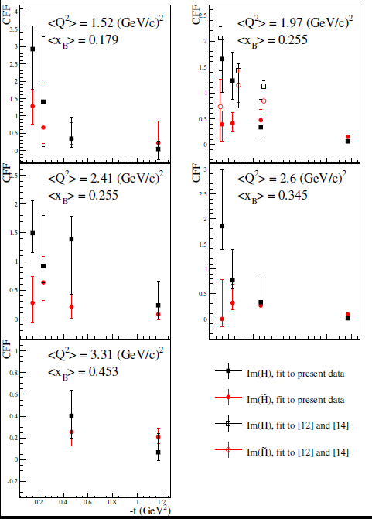
What we learned from CLAS pDVCS asymmetries
Extraction of CFFs from combined analysis
of CLAS data (TSA, BSA, DSA – eg1dvcs)
CFFs fitting code by M. Guidal
M. Guidal, Eur. Phys. J. A 37 (2008) 319, etc…
PROTON TOMOGRAPHY:
ImH has steeper t-slope than ImH : axial charge more “concentrated” than the electric charge
ImH, flatter t-slope at high x_{B}: faster quarks (valence) at the core of the nucleon, slower quarks (sea) at its perifery
~
S. Pisano et al., PRD91 (2015)
z
[12] CLAS BSA (Girod et al.)
[14] CLAS TSA (Chen et al.)
x
Notes:
The DVCS results taken with the 6-GeV beam at JLab taught us that measuring various DVCS observables at the same kinematic point can allow us to extract GPDs in a basically model-independent way. This was done for instance using the CLAS eg1-dvcs data set, which measured, on the proton, BSA, TSA and DSA, using a GPD fitting method by Michel Guidal. The GPDs H and Htilde were extracted, and their kinematical dependence allowed a first attempt of proton tomography. We learned, from the relative slope of the imaginary parts of H and Htilde, that the axial charge is more concentrated in the center of the proton than the electric charge. And, from the t and xB dependency of ImH we learned that the valence quarks are located at the center of the nucleon and the sea quarks at the perifiery.

Slide 11
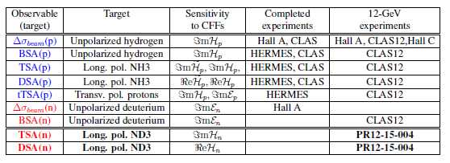
Approved DVCS experiments for JLab@12 GeV
Proton Neutron
A complete experimental program is approved for proton DVCS
(CLAS12, Hall A, Hall C)
Only the beam-spin asymmetry measurement (Im(E_{n})) for neutron DVCS is currently approved for JLab@12 GeV
Notes:
All the spin observables for proton DVCS were measured at JLab@6 GeV and/or HERMES, and will be extracted on wider kinematics and with increased precision at JLab@12 GeV.
From the neutron point of view, pioneering beam-polarized cross sections differences were extracted in Hall A at 6 GeV on limited kinematics, and one experiment is approved for CLAS12 planning to extract beam spin asymmetries. The experiment we propose will fill the gap of the missing neutron DVCS spin observables.

Slide 12
Flavor separation of GPDs
Proton and neutron GPDs (and CFFs) are linear combinations of quark GPDs
A combined analysis of DVCS observables for proton and neutron targets is necessary to perform the flavor separation of the GPDs
Measurements of DVCS on neutron target are crucial for the completion
of a comprehensive GPD program for JLab@12 GeV
We propose to extend the JLab experimental program for
nDVCS, started with the beam-spin asymmetry (E12-11-003), by measuring for the first time target-spin single and double asymmetries
Notes:
Why do we need to measure neutron GPDs? On the one hand, to understand the structure of the neutron. But mostly, because we want to extract GPDs for each quark flavor. Proton and neutron GPDs are linear combinations of quark GPDs. We need to measure DVCS observables on protons and neutrons to perform the flavor separation of GPDs. Given that the proton DVCS program is already fully approved, it is crucial to have a complete DVCS program on the neutron. This is why we propose to measure…

Slide 13
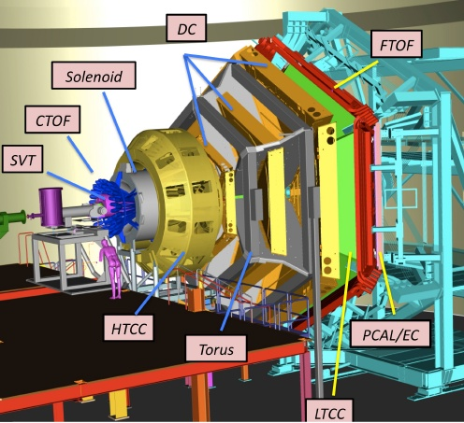
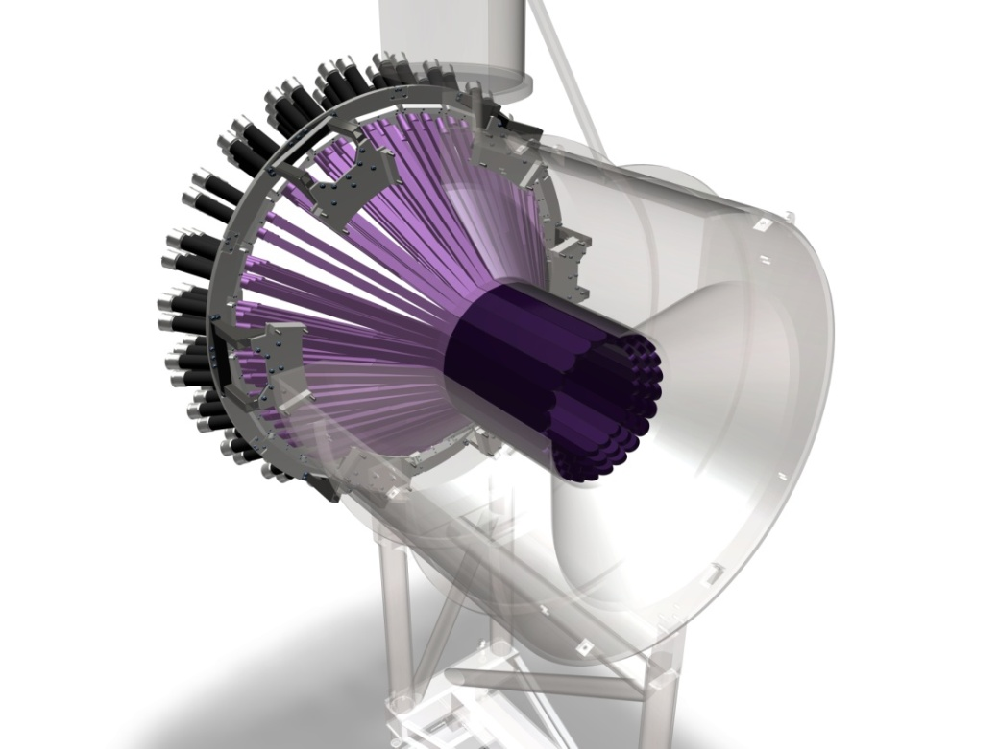
Polarized neutron DVCS setup
Detected in
forward CLAS12
Not detected
→
→
ed→e’nγ(p)
Detected in CND and EC
Detected in
EC+PCAL
CLAS12
CLAS12 polarized target
CND
Notes:
The reaction of interest has a polarized electron beam hitting a longitudinally polarized deuterium target in the initial state, while the final state has scattered electron, recoil neutron, DVCS/BH photon, and a spectator proton.
We plan to use the CLAS12 polarized target, the forward part of CLAS12 to detect the electron, the photon, and the forward emitted neutrons, and the central neutron detector for the backwards emitted neutrons.

Slide 14
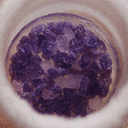
The CLAS12 longitudinally polarized target
Irradiated deuterated ammonia
(ND₃)
UVA, ODU, CNU and JLab
L=4 cm; r = 1.25 cm
P ~ 40%
L ~10³⁴ cm²s⁻¹ /nA
CLAS12
Solenoid (5T)
Pumping system
1K Refrigerator
NMR
Microwaves (140 GHz @ 5T)
Polarizing
Magnet
NMR line shape of ND₃
ND₃ polarization improves with “cold dose”
Notes:
The target is a collaborative effort between the Target group at Jlab, Don Crabb’s Group at Uva, ODU and CNU.
In addition to the target sample, which will be ammonia or deuterated ammonia, you need a high field magnet and low temperature refrigerator. For high luminosity experiments, the combination of 5 T and 1 K seems to work quite well. There has to be large set of vacuum pumps associated with the fridge, a microwave source to drive dynamic polarization, and an NMR system to measure the polarization of the target.
It was observed that by putting a « cold dose » of high-intensity electrons on the ND3 sample, polarizations above 40% could be reached. We plan to do the same for this experiment, so we assumed 40% of average polarization in our estimates for the proposal.

Slide 15

Central Neutron Detector (CND)
Main physics goal: detect the recoiling neutron in nDVCS → The CND must ensure:
good neutron/photon separation for 0.2<p_{n}<1 GeV/c → ~150 ps time resolution
momentum resolution δp/p < 10%
no stringent requirements for angular resolutions
Project status:
CONSTRUCTION COMPLETED
Detector shipped to JLab (9 boxes, 2.5 tons), received on 6/2/2015
HV calibrations of PMTs completed
Simulations for radiation dose
Strength tests for glue
In-field tests for shieldings
Assembly in mechanical structure done in Orsay
Cosmic data analysis: σ_{t} ~150 ps for all blocks
CND design: scintillator barrel - 3 radial layers, 48 bars per layer coupled two-by-two downstream by a “u-turn” lightguide, 144 long light guides with PMTs upstream

Slide 16
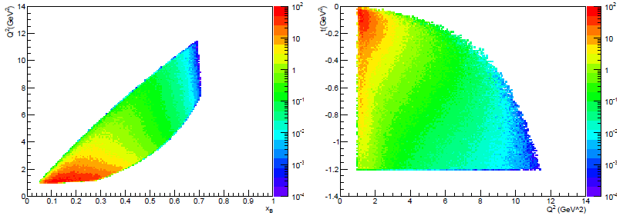
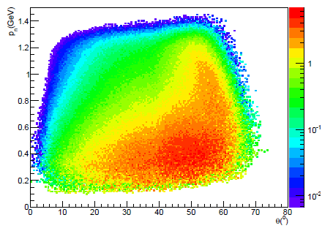
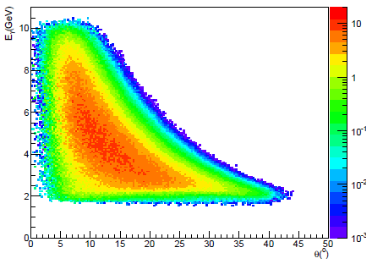
nDVCS@CLAS12: kinematics and acceptances
ed→e’nγ(p)
nDVCS+BH event generator on a FREE deuteron target
+ CLAS12 acceptance from FastMC (eγ)
+ CND efficiency from GEANT4 simulation
80% of neutrons in CND (θ>40°)
E_{e} = 11 GeV, Q²>1 GeV², W>2 GeV², t<-1.2 GeV²
nDVCS-BH photons have E>2 GeV

Slide 17
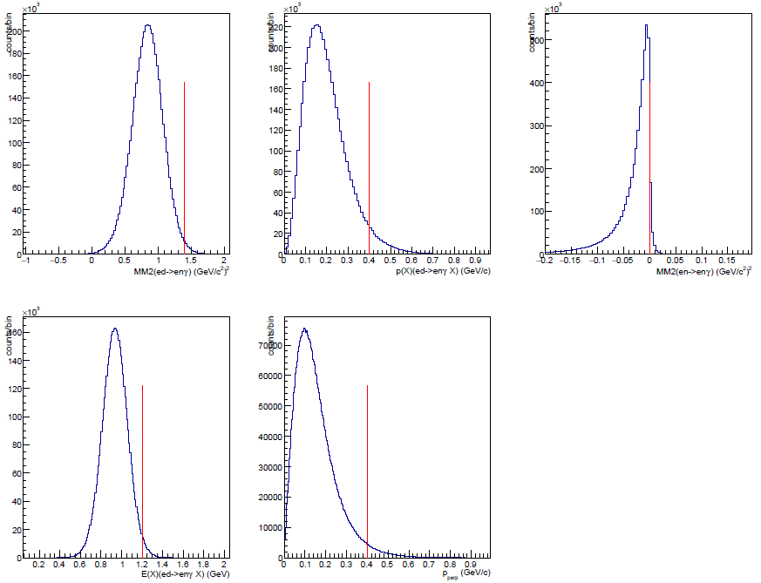
Definitions of nDVCS observables
For each 4-D. bin in (Q², x_{B}, -t, φ)
Target-spin
asymmetry
Im{H_{n}, E_{n}}
Double spin
asymmetry
Re{H_{n}, E_{n}}
MM²(ed→enγX)
p(x)(ed→enγX)
MM²(en→enγX)
Yields extracted applying exclusivity cuts to enγX events
E(x)(ed→enγX)
p_{perp} (en→enγX)
Exclusivity cuts suppress:
nuclear background (¹⁴N)
π⁰ background
accidentals in the CND
Dilution factor
(needs ¹²C data)

Slide 18
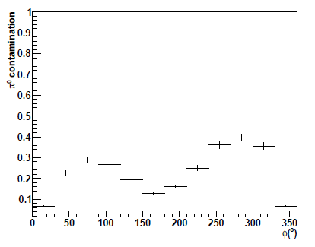
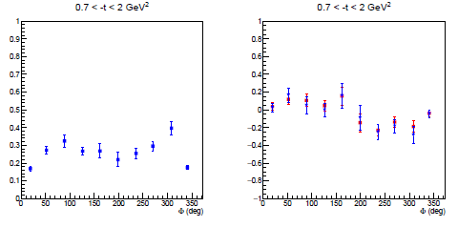
Definitions of nDVCS observables
For each 4-D. bin in (Q², x_{B}, -t, φ)
Target-spin
asymmetry
Im{H_{n}, E_{n}}
Double spin
asymmetry
Re{H_{n}, E_{n}}
b: beam; t: target
FC^{bt}: charge, (Faraday Cup)
B_{π0}: π⁰ contamination
P_{t}: target pol.; P_{b}: beam pol.
D_{f}: dilution factor
Charge-normalized DVCS/BH yield
Projected π⁰ contamination vs φ
π⁰ contamination in the eg1-dvcs pDVCS analysis
TSA (eg1dvcs) before and after π⁰ subtraction
~11% effect on TSA
~6% on DSA

Slide 19
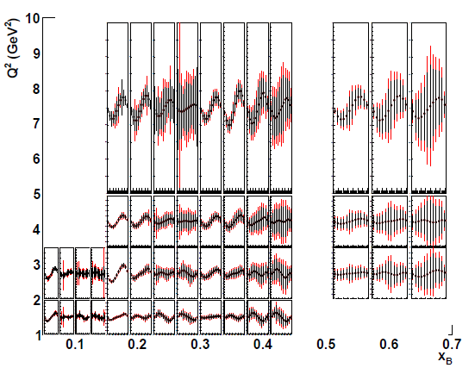
Projected results: target-spin asymmetry
L = 3/20∙10³⁵cm⁻²s⁻¹, Time = 100 days@10 nA + 10 days@5 nA with Forward tagger, P_{t} = 0.4
Count rates computed with nDVCS+BH
event generator
+ CLAS12 acceptance from FastMC
+ CND efficiency from GEANT4 simulation
Asymmetries computed with VGG model
TSA ~ 0.2
1
0
First time measurement
• 4 bins in Q²
• 4 bins in −t
• 4 bins in x_{B}
• 12 bins in φ
(Same as E12-11-003)
-1
Red points = 50 days

Slide 20
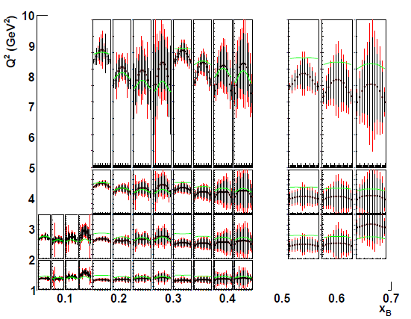
Projected results: double spin asymmetry
L = 10³⁵cm⁻²s⁻¹ for ND³ @ 10 nA, Time = 100 days
D_{f} = 0.7; P_{t} = 0.4; P_{b} = 0.85
Count rates computed with nDVCS+BH
event generator
+ CLAS12 acceptance from FastMC
+ CND efficiency from GEANT4 simulation
Asymmetries computed with VGG model
DSA up to 0.8
1.2
0
First time measurement
• 4 bins in Q²
• 4 bins in −t
• 4 bins in x_{B}
• 12 bins in φ
(Same as E12-11-003)
-0.6
Red points
if Forward Tagger can be used
Green curves: BH

Slide 21
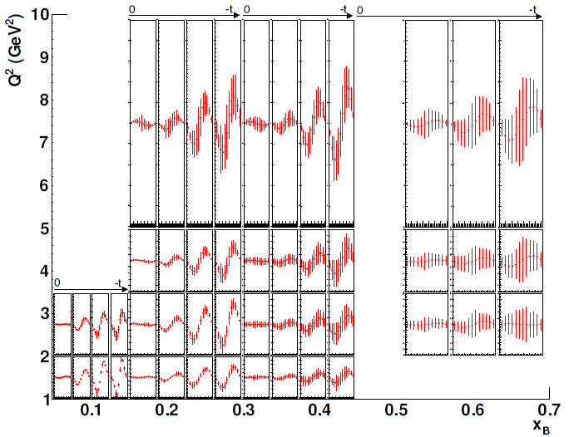
Projected beam spin asymmetry from E12-11-003
L = 10³⁵cm⁻²s⁻¹ for LD, Time = 80 days; P_{b} = 0.85
Count rates computed with nDVCS+BH
event generator
+ CLAS12 + FT acceptance from FastMC
+ CND efficiency from GEANT4 simulation
Asymmetries computed with VGG model
BSA ~ 0.05
0.25
0
• 4 bins in Q²
• 4 bins in −t
• 4 bins in x_{B}
• 12 bins in φ
-0.25
High-impact experiment

Slide 22
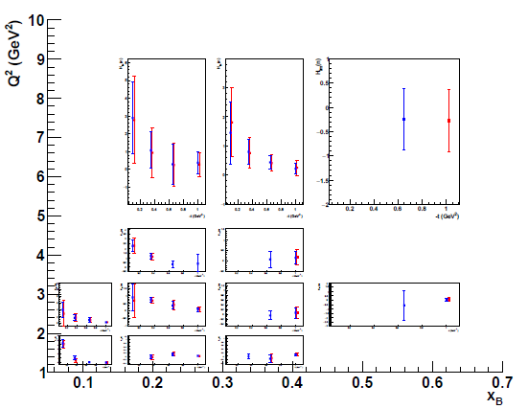
Combined analysis of PR12-15-004 and E12-11-003
110 days
50 days
ImH_{n}
Extraction of neutron CFFs using M. Guidal’s fitting code. Fit of TSA, DSA (PR12-15-004) and BSA
(E12-11-003)
7 CFFs as free fit parameters
ImE = 0
~

Slide 23
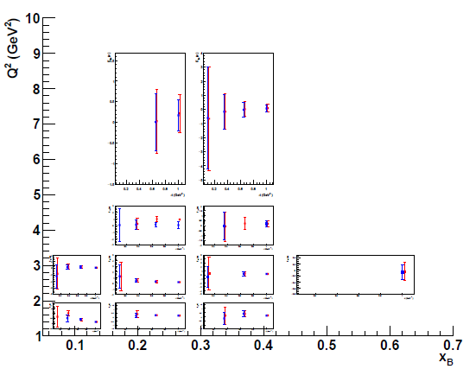
Combined analysis of PR12-15-004 and E12-11-003
110 days
50 days
ImE_{n}

Slide 24
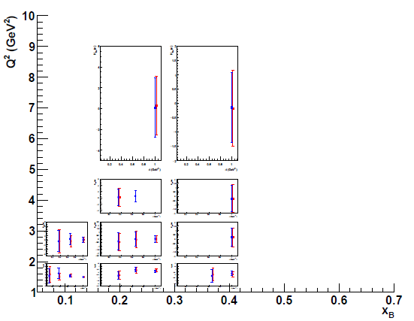
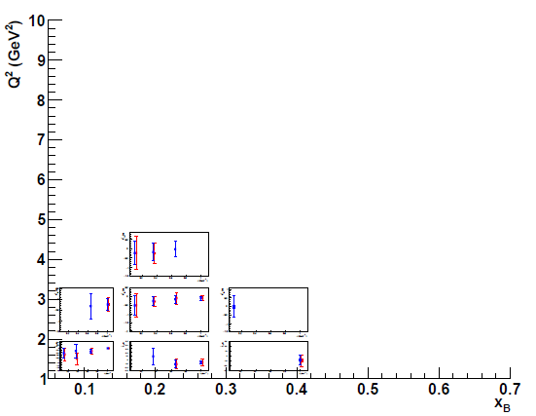
Combined analysis of PR12-15-004 and E12-11-003
110 days
50 days
ReH_{n}
~
ImH_{n}

Slide 25
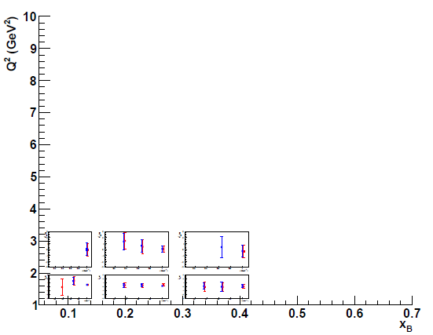
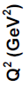
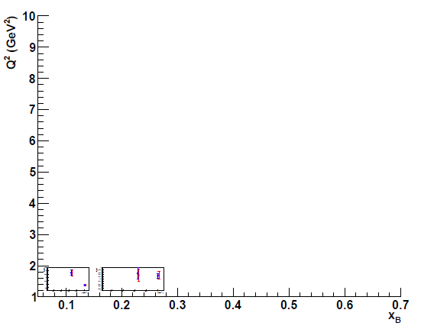
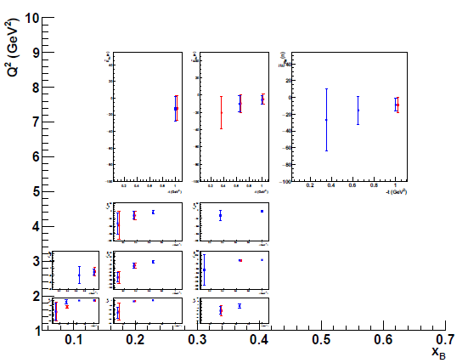
Combined analysis of PR12-15-004 and E12-11-003
110 days
50 days
~
ReH_{n}
~
ReE_{n}
ReE_{n}

Slide 26
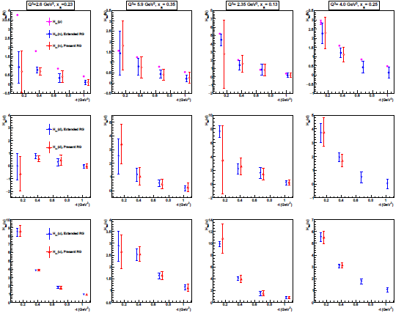
Projections for flavor separation (ImH)
Fit using all the projected pDVCS asymmetries of the CLAS12 program
Fit using the projected nDVCS asymmetries of PR12-15-004 and E12-11-003
σ(pDVCS) ≈
10σ(nDVCS)
Neutron eff = 10%
~ Same beam time for p and n

Slide 27
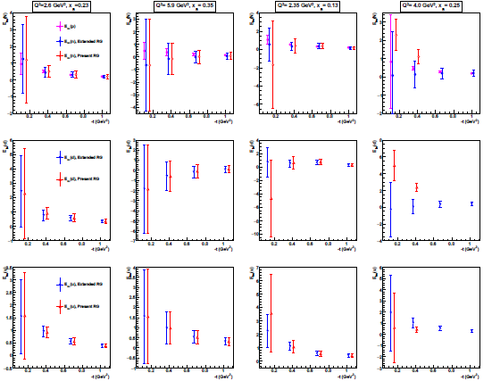
Projections for flavor separation (ImE)
Fit using all the projected pDVCS asymmetries of the CLAS12 program
Fit using the projected nDVCS asymmetries of PR12-15-004 and E12-11-003
σ(pDVCS) ≈
10σ(nDVCS)
Neutron eff = 10%
~ Same beam time for p and n

Slide 28
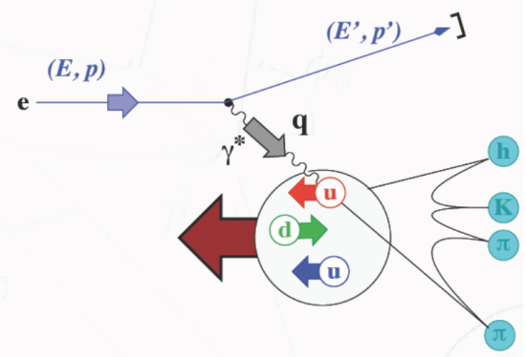
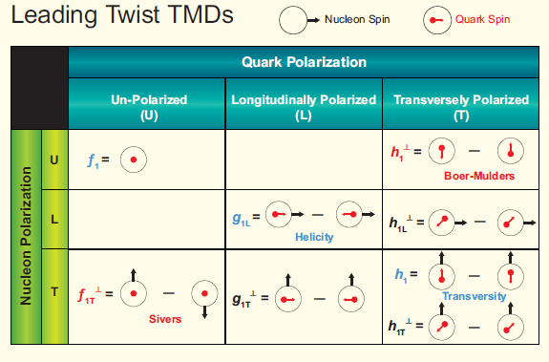
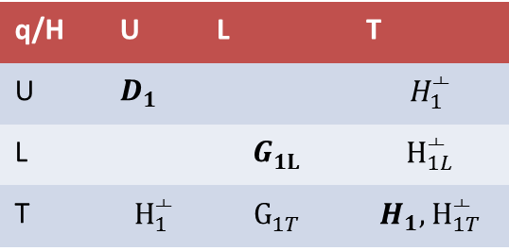
Transverse Momentum Dependent PDFs&FFs
8 leading-twist TMDs
They depend on the parton longitudinal momentum fraction x
and on its transverse momentum k_{T}
→ 3D dynamics
Fragmentation Functions → transition from partonic to hadronic degrees of freedom
q/H | U | L | T
U | $D_{1}$ |  | $$H_{1}^{┴}$$
L |  | $$G_{1L}^{}$$ | $$H_{1L}^{┴}$$
T | $$H_{1}^{┴}$$ | $$G_{1T}^{}$$ | $$H_{1}{, H}_{1T}^{┴}$$

Slide 29
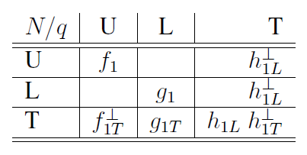
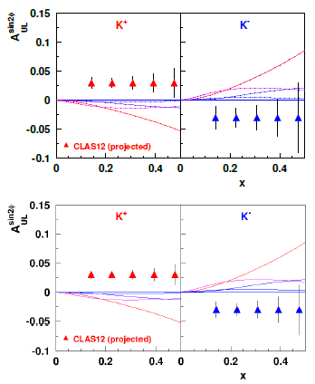
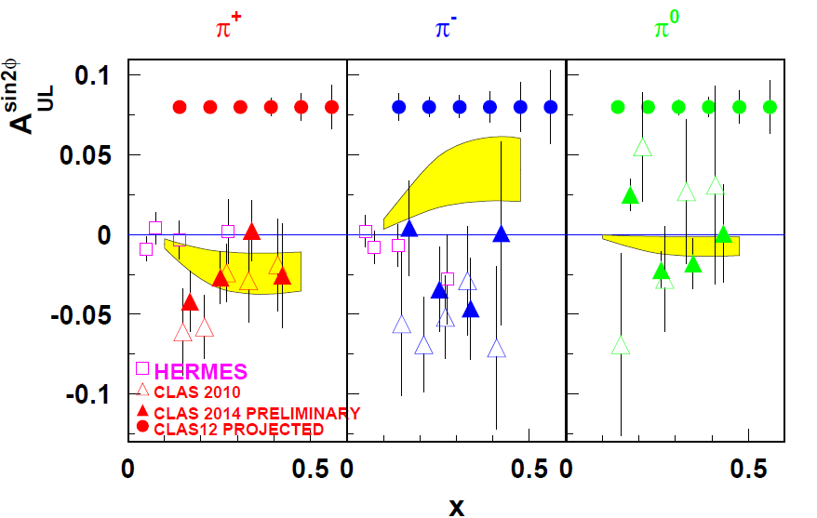
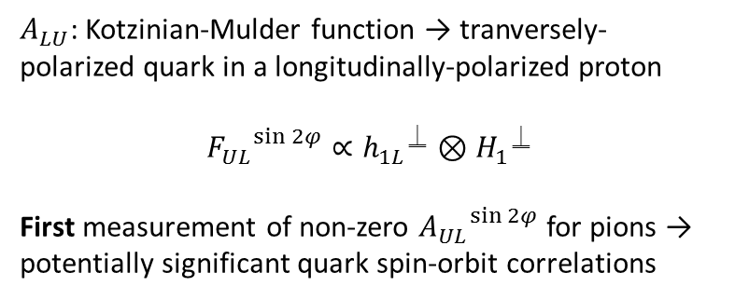
Off-diagonal TMDs: Kotzininan-Mulder
$A_{LU}$: Kotzinian-Mulder function → tranversely-polarized quark in a longitudinally-polarized proton
$${F_{UL}}^{\sin{2φ}}∝{h_{1L}}^{⍊}⊗{H_{1}}^{⍊}$$
First measurement of non-zero ${A_{UL}}^{\sin{2φ}}$ for pions → potentially significant quark spin-orbit correlations
50 days
100 days
JLab12 meeting – June 30th, 2016.

Slide 30
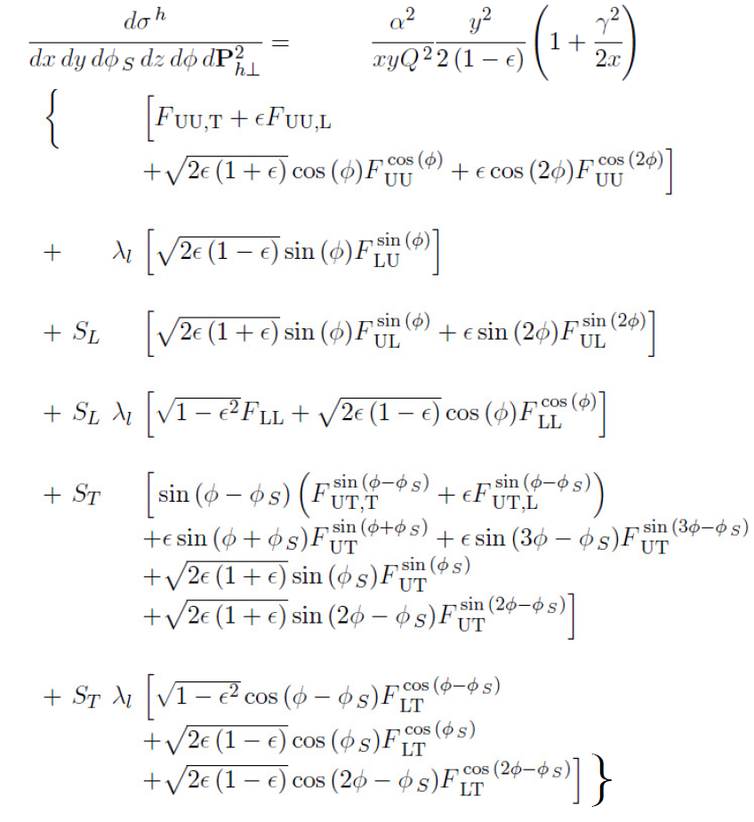
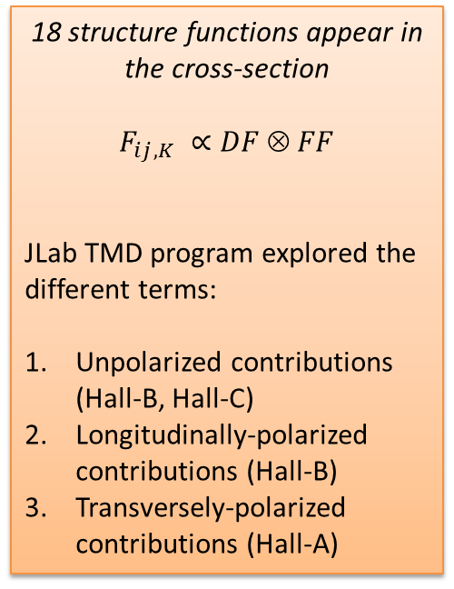
Single-hadron SIDIS cross-section
Depending on the degrees of freedom at play, various TMD&&FF can be accessed:
18 structure functions appear in the cross-section
$$F_{ij,K} ∝DF  FF$$
JLab TMD program explored the different terms:
Unpolarized contributions (Hall-B, Hall-C)
Longitudinally-polarized contributions (Hall-B)
Transversely-polarized contributions (Hall-A)
Unpolarized target
Longitudinally pol. target
Tranversely pol. target

Slide 31
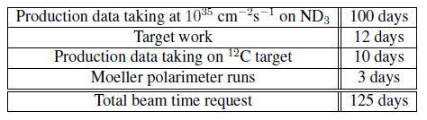
Summary of setup and beam-time request
Experimental setup:
CLAS12
Longitudinally polarized ND₃ target (P_{t}~40%)
Central Neutron Detector (ready!)
Beam energy: 11 GeV
Beam polarization: 85%
Half of the requested beam time can be shared with Run Group Cb
We request 62 days of new beam time

Slide 32
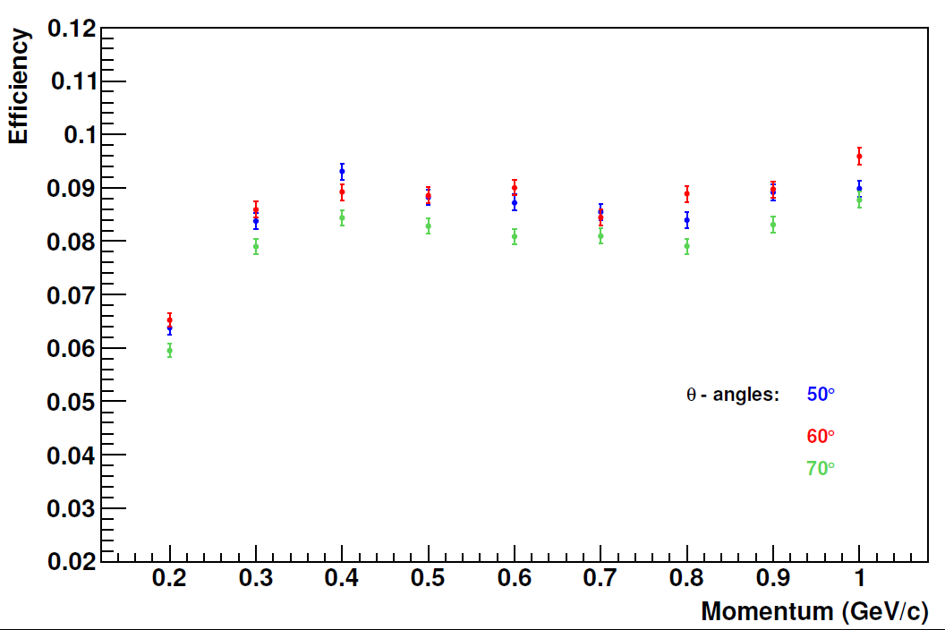
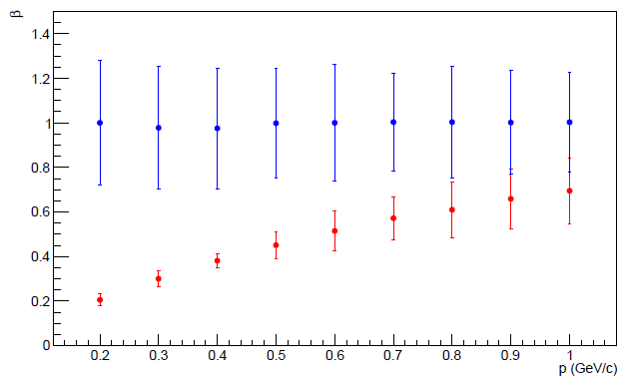
CND: expected performances (Monte Carlo)
GEANT4 simulations used to evaluate:
efficiency
PID (neutron/photon separation)
momentum and angular resolutions
definition of reconstruction algorithms
background studies
Measured σ_{t} and light loss due to u-turn implemented in the simulation
Efficiency ~ 8-9%
for a threshold of 3 MeV, TOF<8 ns
and p_{n} = 0.2 - 1 GeV/c
PMT-N
PMT-D

